Slide 2
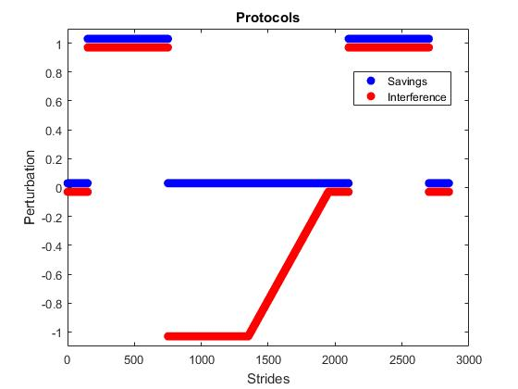
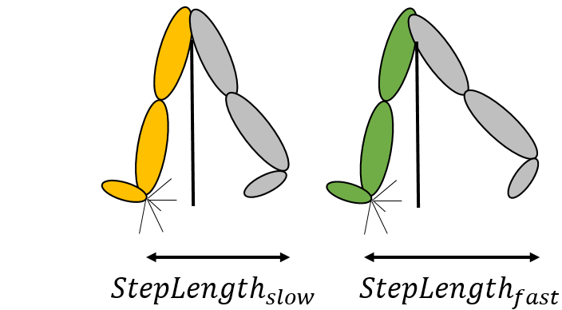

Protocols
Outcome parameter
1.4
0.7
Step length asymmetry (SLA)
Adaptation 1 (A1)
Adaptation 2 (A2)
Right belt speed [m/s]
Perturbation
Left belt speed [m/s]
Counter-adaptation (B)
$SLA=\frac{(StepLength_{slow}−StepLength_{fast})}{(StepLength_{slow}+ StepLength_{fast})}$
0.7
1.4
Strides

Slide 3
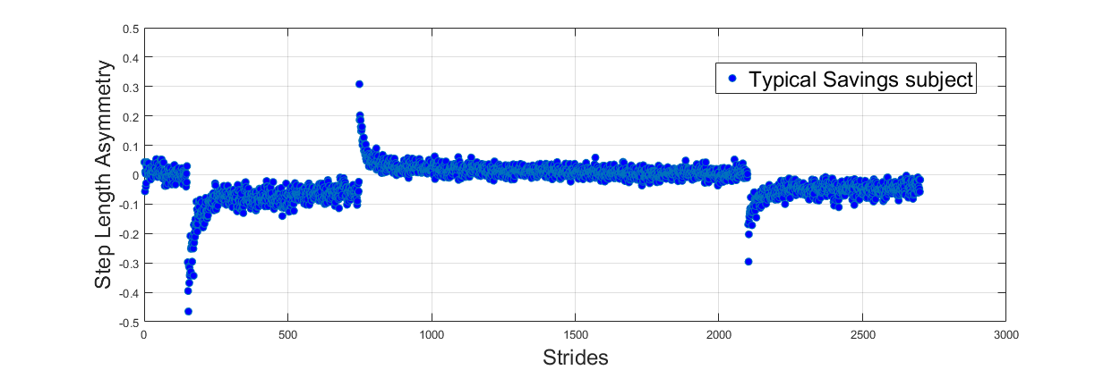
Adaptation 1 (A1)
Adaptation 2 (A2)
Late adaptation (:30)
Late adaptation (:30)
Early adaptation (6:30)
Early adaptation (6:30)
Very early adaptation (1:5)
Very early adaptation (1:5)

Slide 4
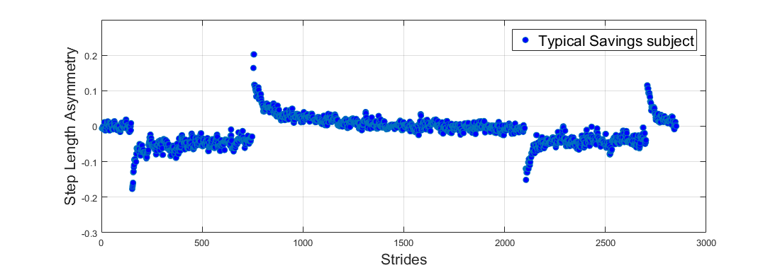
Adaptation 1 (A1)
Adaptation 2 (A2)
Late adaptation (:30)
Late adaptation (:30)
Early adaptation (6:30)
Early adaptation (6:30)
Very early adaptation (1:5)
Very early adaptation (1:5)

Slide 5
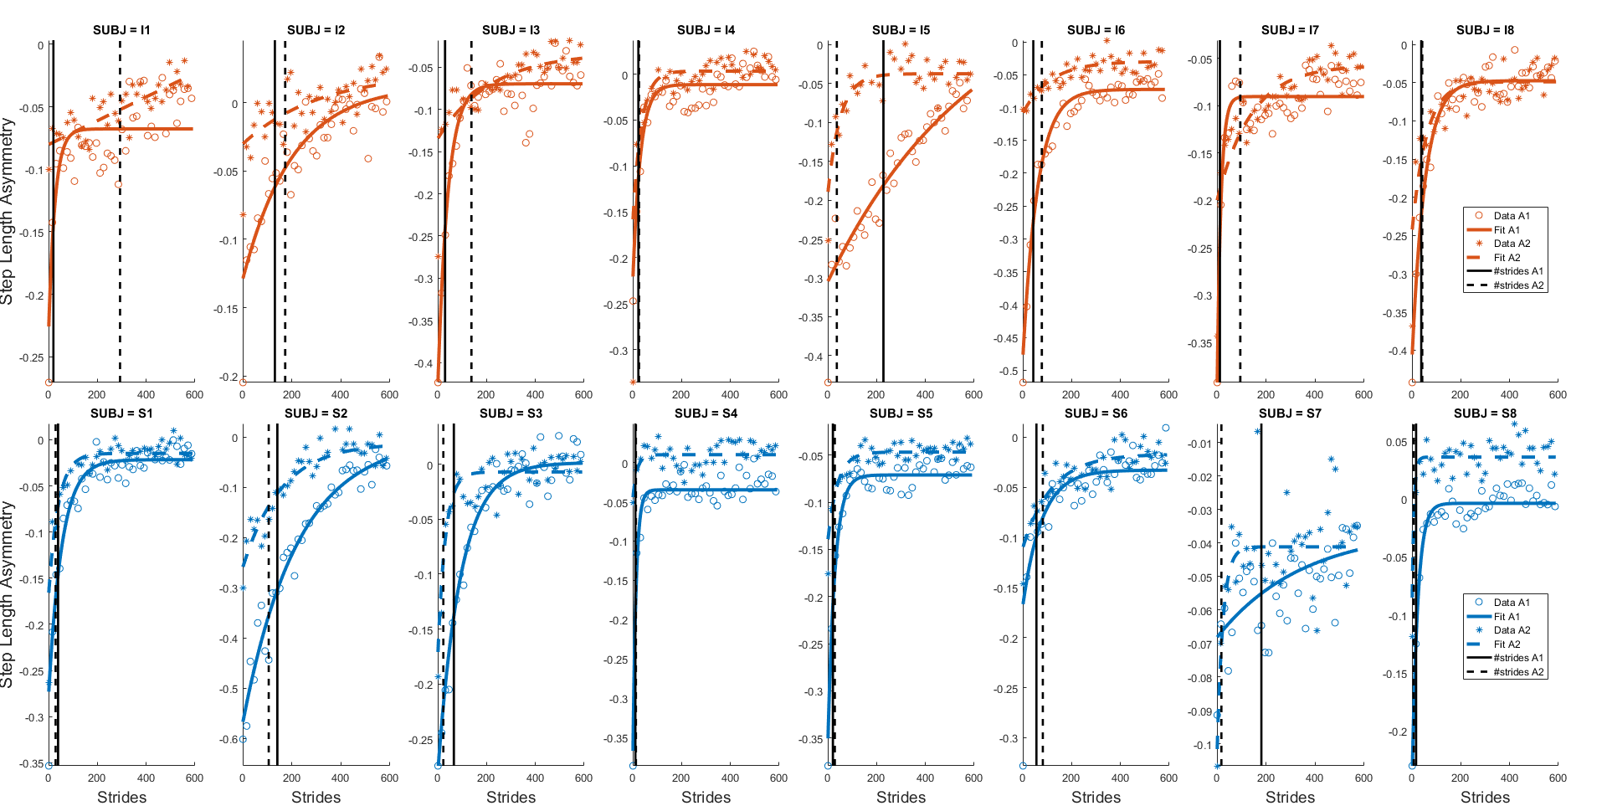
Interference group
Savings group

Slide 6
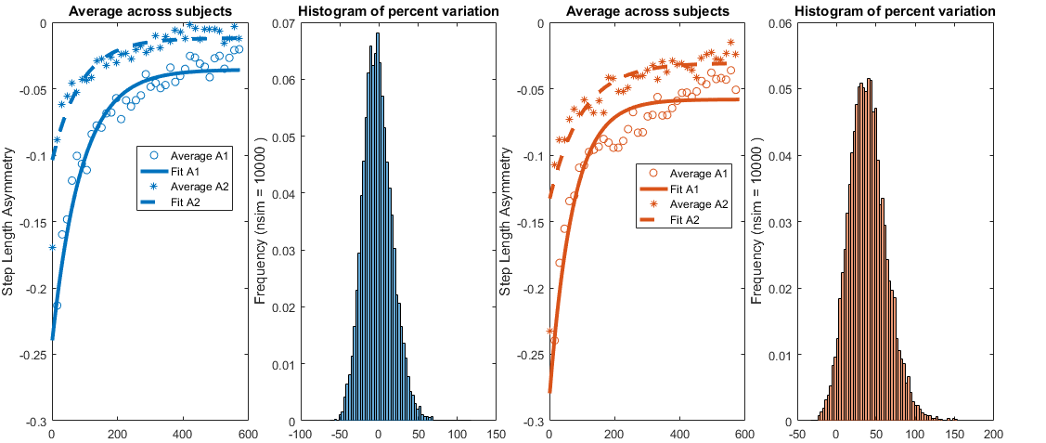


Savings group
Interference group
Strides
$$PV=\frac{τ_{A2} −τ_{A1}}{τ_{A1}}∗100 [\%]$$
Strides
$$PV=\frac{τ_{A2} −τ_{A1}}{τ_{A1}}∗100 [\%]$$

Slide 7
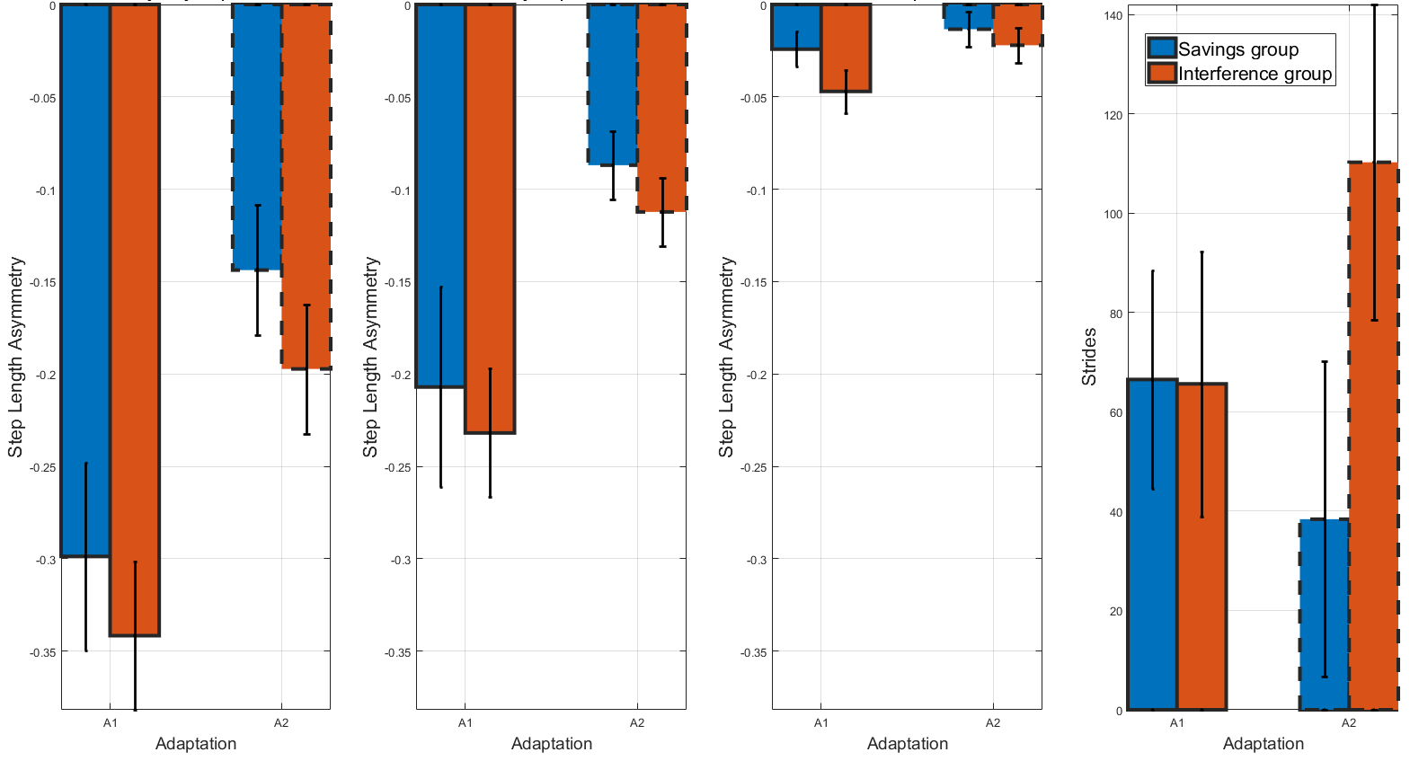
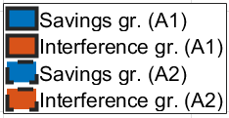
[
[
[
Very early adaptation
Early adaptation
Late adaptation
#Strides to Mid-Pert
[
[
[
[
[
[
*
*
*

Slide 8


$$StepLength_{slow}$$
$$StepLength_{fast}$$

Slide 9


$$Short Step$$
$$Long Step$$

